Slide 1

A Recipe Retrieval App
Team : CodeSquad

Slide 2
App Use Cases :
> Food enthusiasts wanting to sharpen their culinary skills
>Health conscious tourists who love to binge
>Blessing for Masters students!

Slide 3
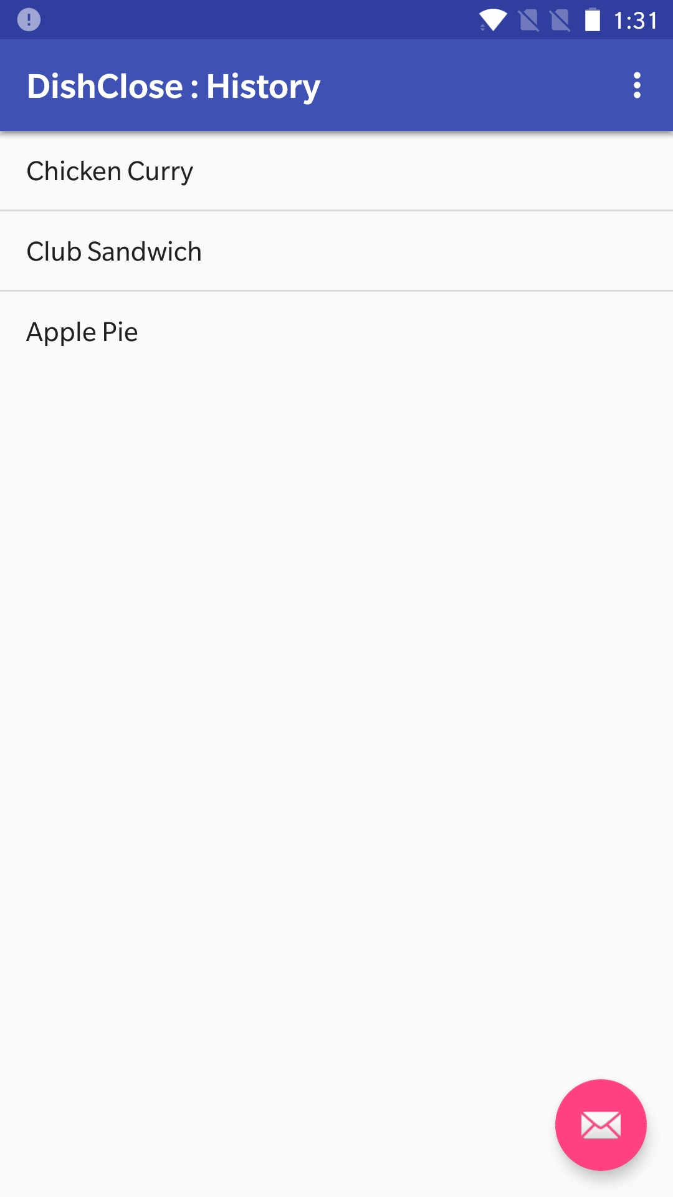
User Perspective ?
Access to search history

Slide 4
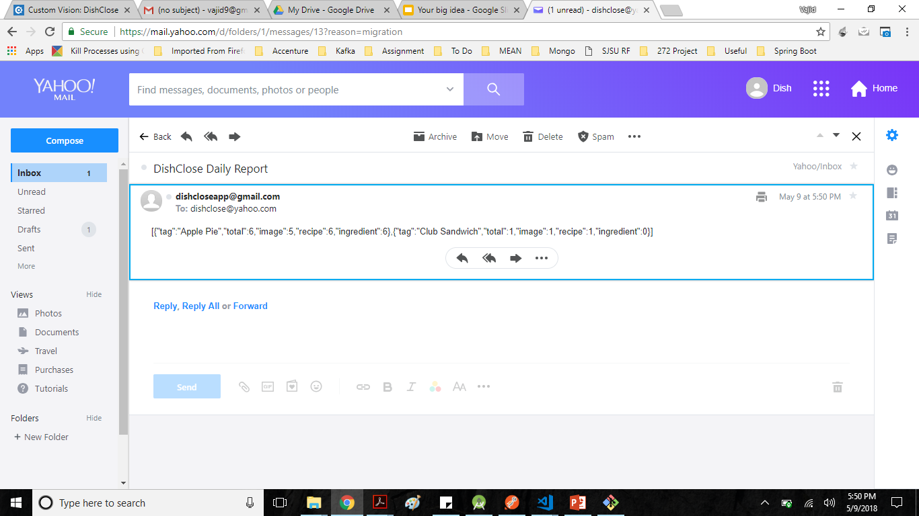
Admin Perspective ?
Daily Email Reports of the Feedback

Slide 5

Scalability ?
Data stored on MongoDB !

Slide 6
Present Scope ?
Trained on 7 dishes
Real time processing capability

Slide 7
Future Scope ?
Diversify recognition range
Suggest popular dishes based on geolocation
Have pictures with ingredients
Show customized toppings

Slide 8
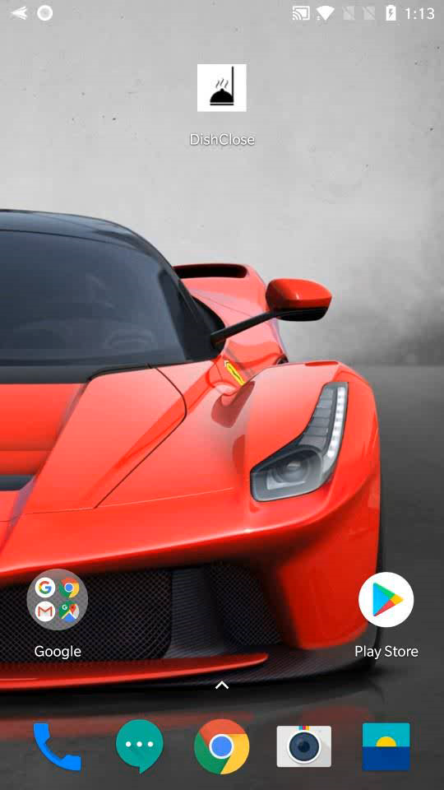
DEMO

